Slide 1
Graphics - Robot Model
By Frank Paul Haecker

Slide 2
Overview
Creating model
Coloring and Texture Mapping
Transformation
Demonstration

Slide 3
Goals
Create robot model from scratch
Identify coordinates
Identify indices
Allow view manipulation of model
Zoom in and out
Rotate model multiple ways
Translate model to simulate movement
Realistic appearance
Add appropriate colors to surfaces
Add texture mapping for high level of detail
Perspective viewing

Slide 4
Create Robot Model
Define point coordinates
x, y, and z value for every point used to draw model
Define indices
Each line consists of all points in a single polygon drawn
4 point polygons used for this model – 4 points for 1 plane
Multiple planes combine to create 3d objects
Model stats
140 points used
107 indices used (planes)
22 different groups

Slide 5
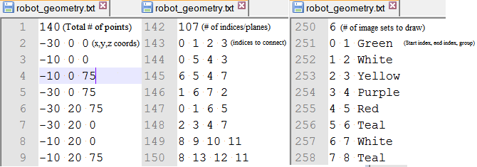
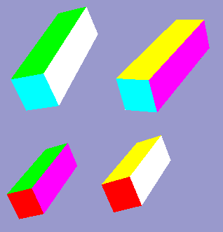
Robot Model Example
“robot_geometry.txt” defines model
Points, indices, groups
Group name used later to indicate color/texture
Example shown on left

Slide 6
Coloring and Texture
Color and texture selection decided by group
Colors/textures predefined in ColorEntry table
ColorEntry – Consists of 3 parts
RBG values for color (between 0 and 1)
Group name assocaited
Texture value
Pointer to the loaded texture to apply
Set to 0 if no texture is to be used

Slide 7
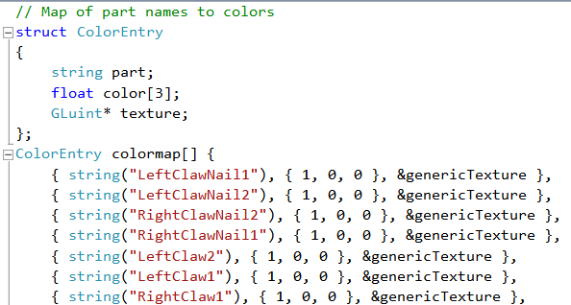
Colormap Code
ColorEntry struct shown with predefined colormap values

Slide 8
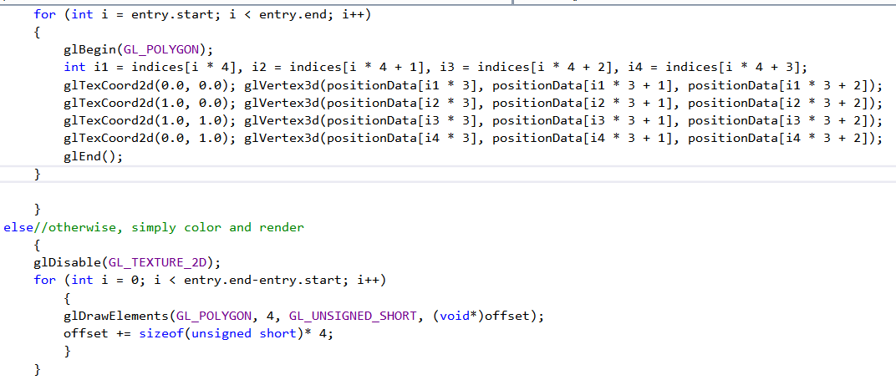
Color/Texture Application Code
For all elements in the set, match coords of texture to coords of model entry
If no texture is present, simply draw using the given color

Slide 9


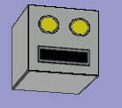
Texture Mapping Example
Robot head texture (left)
Robot generic body texture (middle)
Robot model with head and body textures (right)

Slide 10
Model Transformation
All model transformation performed by matrix multiplication
All matrices are predefined and named for the type of rotation they are to perform
Transformation supported include the following:
Zoom in and out
Translate model forwards and backwards
Rotate model left and right
Flip and turn model

Slide 11
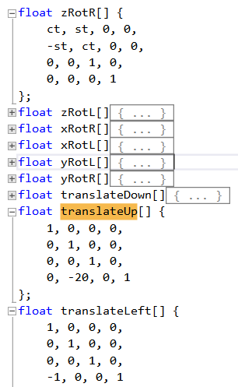
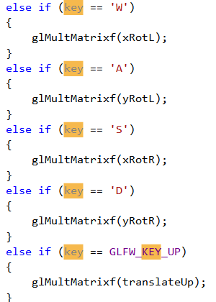
Code Example - Matrices
Predefined matrices shown (left)
Multiplication performed on key press (right)

Slide 12
Demonstration

Slide 13
Questions

